Slide 1


ANY SOFTWARE TOOL TO TACKLE PROBLEMS SPECIFIC TO UTTARAKHAND
Presenter-
Vaishnavi

Slide 2
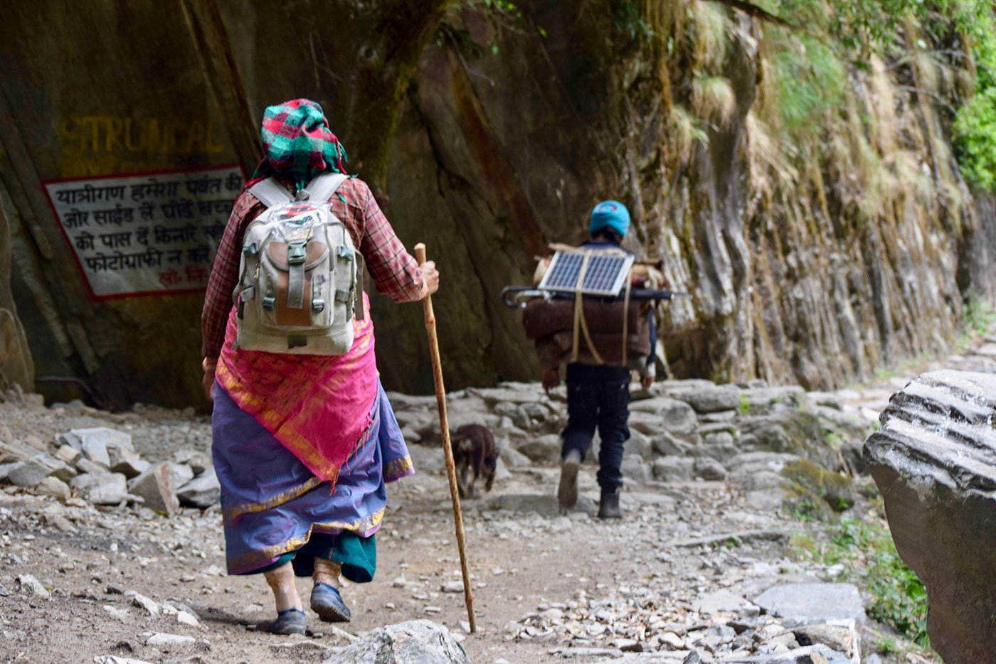
Background: Migration Issue in Uttarakhand
1
Migration Issue
Migration has been a significant issue in Uttarakhand, primarily driven by economic factors and limited employment opportunities in the region.
2
Challenges
The hilly terrain and dependence on agriculture have contributed to challenges in sustaining local economies, prompting individuals to seek opportunities elsewhere.
3
Impact
Factors such as seasonal employment, inadequate infrastructure, and the impact of natural disasters have intensified the migration trend.

Slide 3

Objectives:
Empowering Local Businesses
Provide a platform for local businesses and
artisans to showcase and sell their products.
Mitigating Migration
Reduce migration by creating viable
economic opportunities within Uttarakhand.
Economic Sustainability
Foster a sustainable local economy through
increased visibility and sales for businesses.

Slide 4

BENEFITS FROM PAHADI PRODUCTS:
Millets:
Barnyard millet, Finger millet, Faoxtail millet etc. are cultivated in various regions of Uttarakhand. It is used to make porridge, kheer (sweet pudding), and Flour also. These millets are highly nutritious, rich in dietary fibre, and gluten-free.
2. Buransh and Malta Squash:
These juices are great for healing inflammation, and liver ailments, and reduce arthritis pain, bronchitis and grout.
3. Cereals and Grains:
Cereals contain high levels of carbohydrates but are good sources of Dietary Fiber, Vitamin A, B6, B12, C, Calcium, Phosphorus, amino acids and other minerals.

Slide 5

Methodology: Frontend Development
Wireframing and Design
Choose Frontend Technologies
Create wireframes to plan the layout and structure of the website.
Select appropriate frontend technologies based on project requirements (HTML, CSS, JavaScript).
Responsive Design
Ensure the website is responsive, adapting to various screen sizes for optimal user experience on different devices.

Slide 6



Progress and Status
Milestones Achieved
Successfully designed the frontend of e-commerce website, aiming to provide a digital marketplace for local businesses in Uttarakhand.
Work in Progress
Implement client-side functionalities using JavaScript. Incorporate interactive elements, such as image sliders, dropdowns, and form validations.
Ongoing Efforts
Developing additional support mechanisms for vendors, including workshops and resources to optimize their online presence.

Slide 7
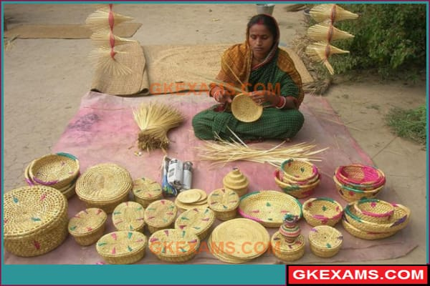
User Engagement
1
Strategies for Engaging Users
2
Strategies for Engaging Local Businesses
Leverage social media platforms to share stories, testimonials, and behind-the-scenes glimpses of local businesses, fostering a sense of connection.
Encourage vendors to join workshops or webinars to educate local businesses on optimizing their online presence, marketing strategies, and effective use of the platform.
3
Main Points
The e-commerce platform contributes to local economic sustainability, reducing migration dependency.

Slide 8

Conclusion and Key Takeaways
1
Conclusion
The e-commerce initiative aims to address migration in Uttarakhand by creating local economic opportunities through a digital marketplace.
2
Key Takeaways
The e-commerce platform contributes to local economic sustainability, reducing migration dependency.

